Slide 1
Error Detection and Correction
Types of Errors
Detection
Correction

Slide 2
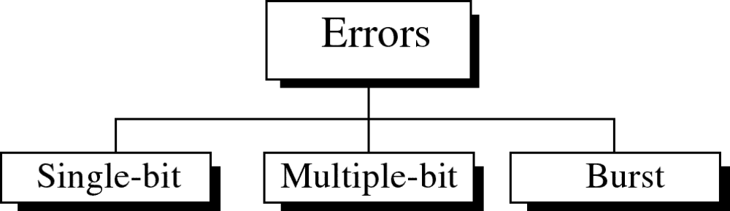

Slide 3
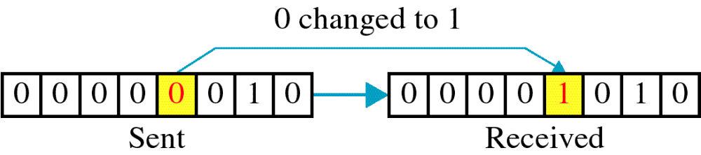
Single-bit error

Slide 4
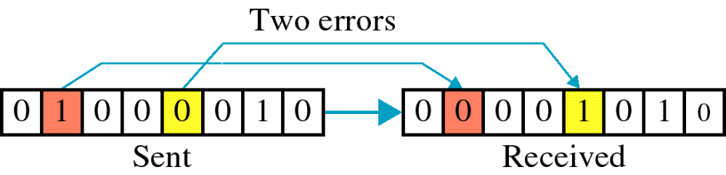
Multiple-bit error

Slide 5
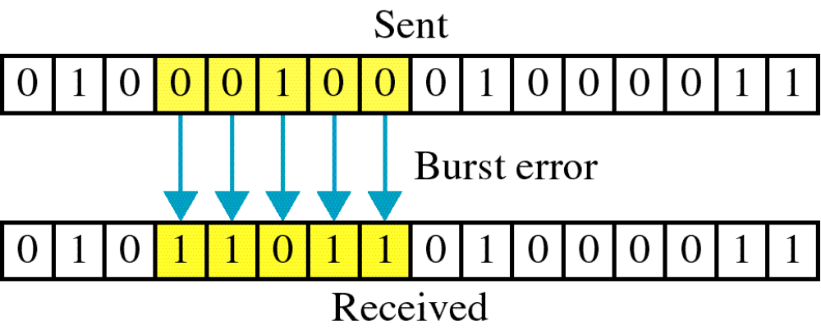
Burst error

Slide 6
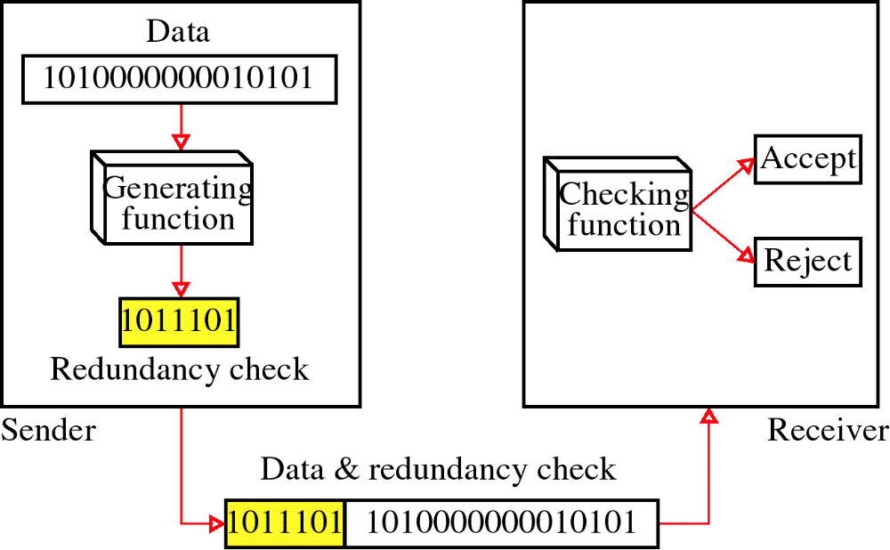
Error Detection -Redundancy

Slide 7
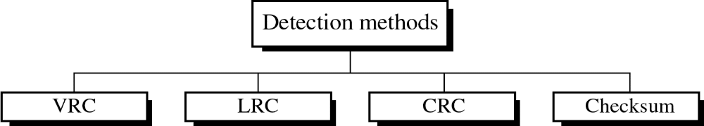
VRC – Vertical Redundancy Check (Parity Check)
LRC – Longitudinal Redundancy Check
CRC – Cyclic Redundancy Check
Checksum

Slide 8
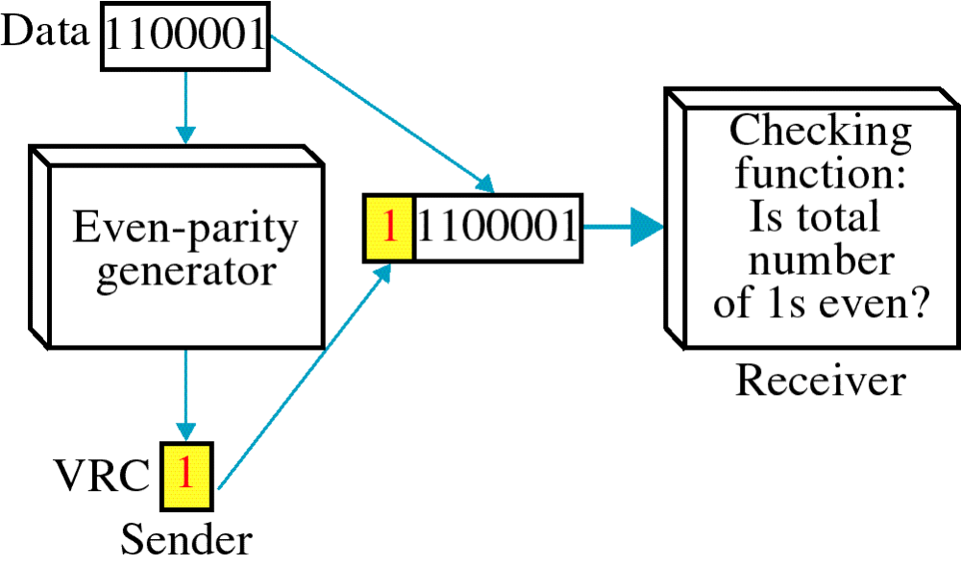
VRC

Slide 9
Example:
1110011 1101111 1010010 1101100
11100111 11011110 10100101 11011000
VRC can detect all single-bit errors.
It can detect burst errors only if the total number of errors in each data unit is odd.

Slide 10
LRC
11100111 11011101 00111001 10101001
        11100111
        11011101
        00111001
        10101001
        LRC 10101010
10101010 10101001 00111001 11011101 11100111
If two bits in one data unit are damaged and two bits in exactly the same positions in another data unit are also damaged.
Ex. : 11110000 11000011 changed to 01110001 01000010

Slide 11
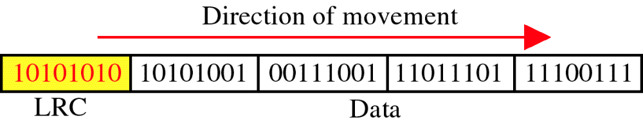
LRC

Slide 12
Cyclic Redundancy Check (CRC)
CRC is based on binary division
Bit strings represented as polynomials with co ef. 0 and 1.
K bit frame =>x^{k-1}+…+1 (first and last co ef must be 1)
Example
  110001 => x⁵+x⁴+1
Polynomial arithmetic is done module 2 i.e. ⬄ addition/subtraction = XOR operation

Slide 13
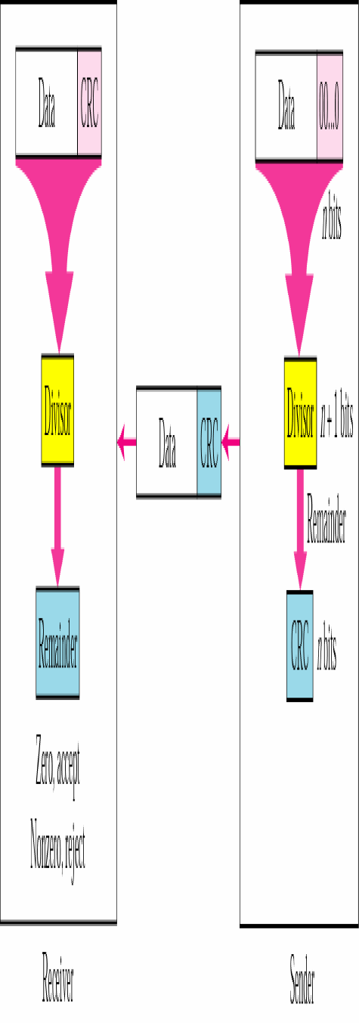

Slide 14
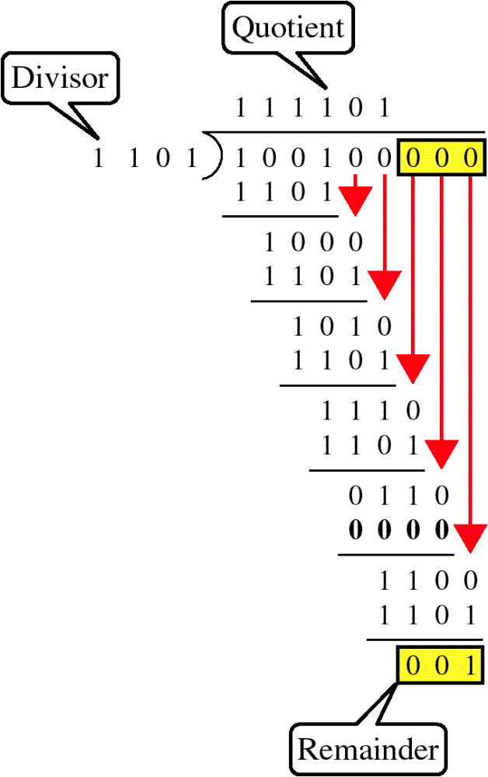
Binary Division

Slide 15
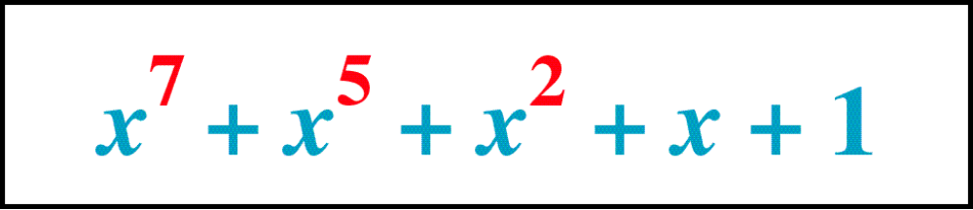
Figure 9-12
Polynomial
WCB/McGraw-Hill
© The McGraw-Hill Companies, Inc., 1998

Slide 16
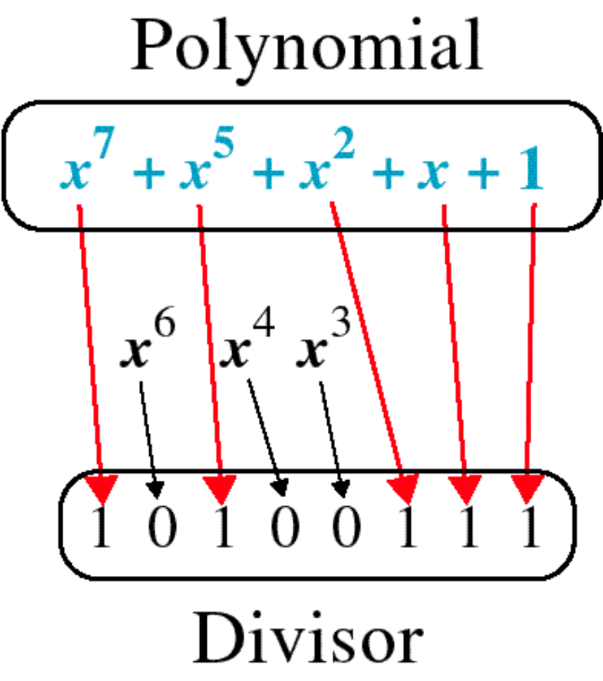
Figure 9-13
Polynomial and Divisor
WCB/McGraw-Hill
© The McGraw-Hill Companies, Inc., 1998

Slide 17
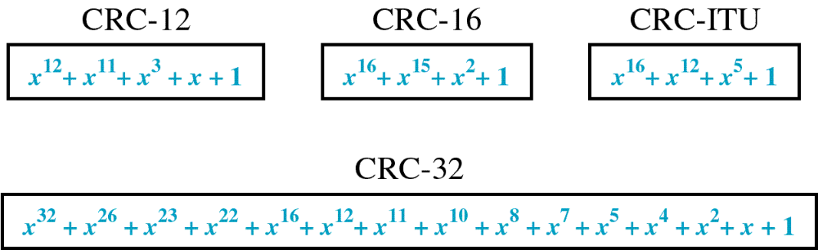
Figure 9-14
Standard Polynomials
WCB/McGraw-Hill
© The McGraw-Hill Companies, Inc., 1998

Slide 18
Given a 10-bit sequence 1010011110, and a divisor of 1011, find the CRC.

Slide 19
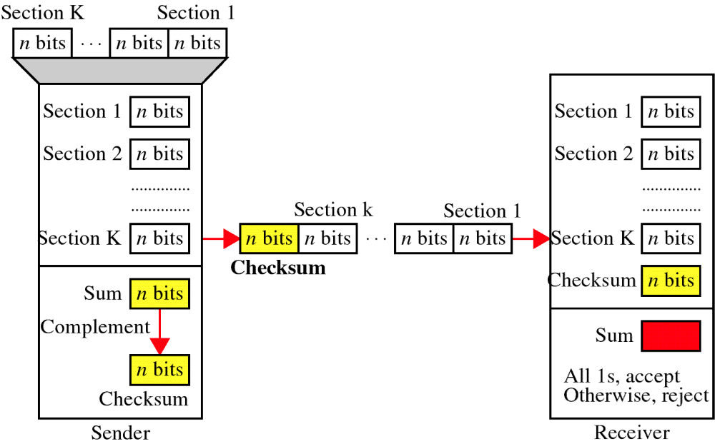
Checksum

Slide 20
CheckSum
The sender follows these steps:
•The unit is divided into k sections, each of n bits.
•All sections are added.
•The sum is complemented and becomes the checksum.
•The checksum is sent with the data
The receiver follows these steps:
•The unit is divided into k sections, each of n bits.
•All sections are added to get the sum.
•The sum is complemented.
•If the result is zero, the data are accepted.

Slide 21
Example-4: CheckSum
Suppose the following block of 16 bits is to be sent using a checksum of 8 bits.
10101001 00111001
The numbers are added
10101001
00111001
-------------
Sum 11100010
Checksum 00011101 ; complemented
The pattern sent is 00011101 00111001 10101001

Slide 22
Example-4 Continue
Now suppose the receiver receives the pattern sent in is
00011101 00111001 10101001
When the receiver adds the three sections, it will get all 1s,
which, after complementing, is all 0s and shows that there
is no error.

Slide 23
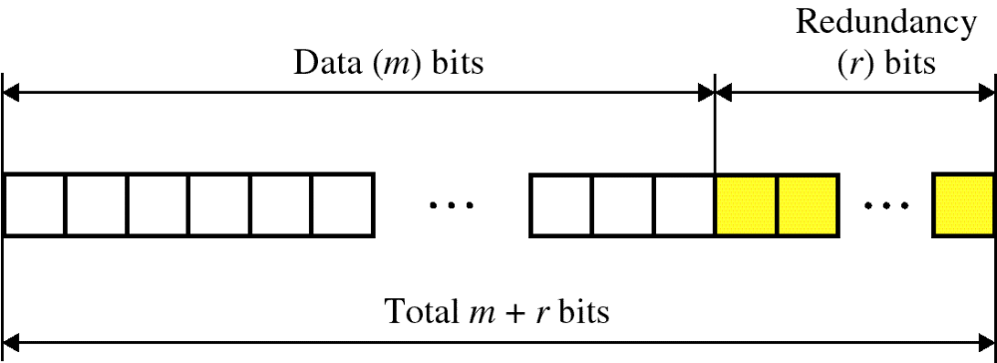
Error Correction
2^{r} >= m+r+1, Here r=4

Slide 24
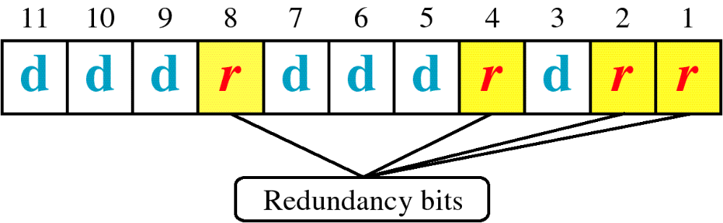
Hamming Code
r1: 1,3,5,7,9,11
r2: 2,3,6,7,10,11
r4: 4,5,6,7
r8: 8,9,10,11

Slide 25
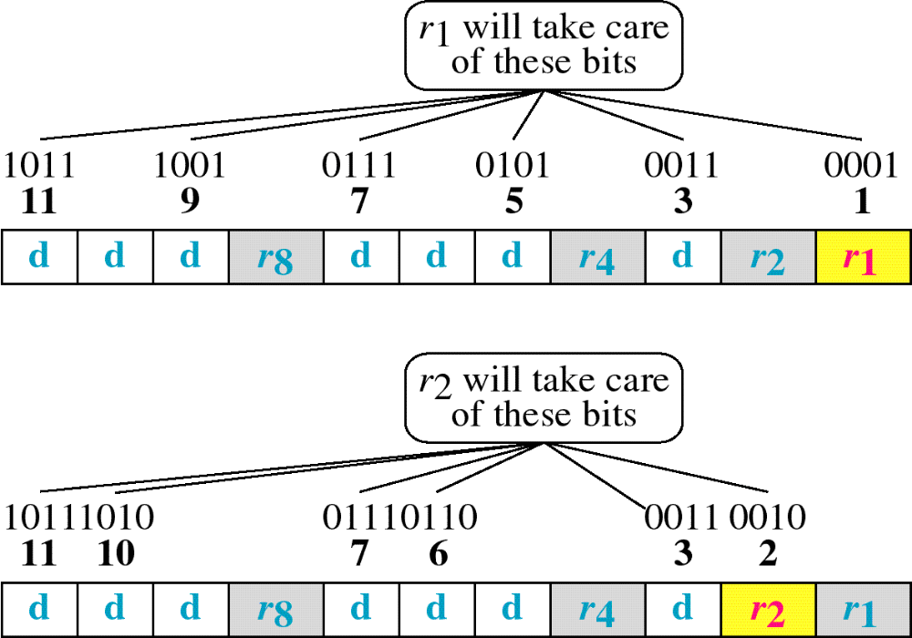
Hamming Code

Slide 26
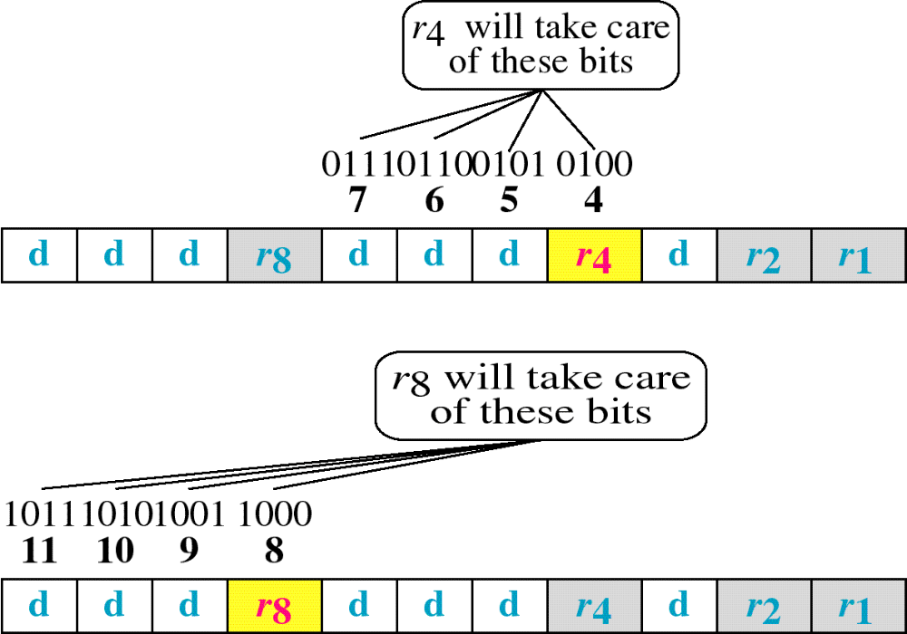
Hamming Code

Slide 27
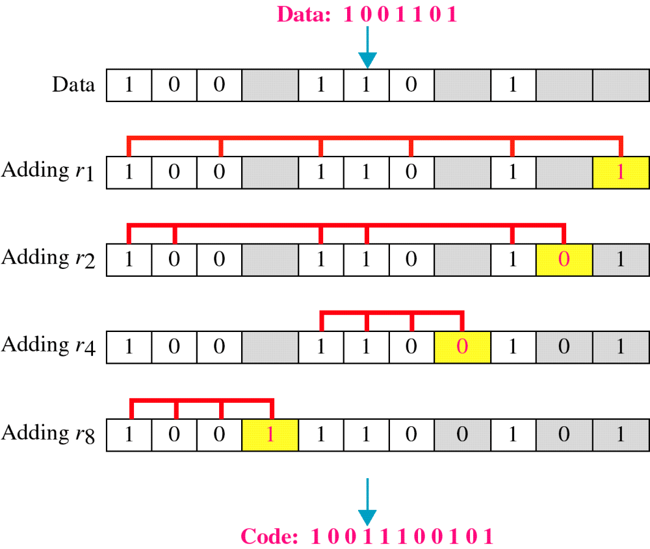
Example of Hamming Code
10011100101

Slide 28
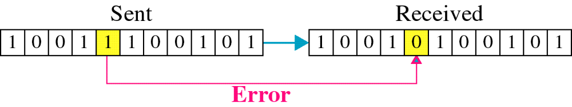
Single-bit error

Slide 29

Error
Detection

